Slide 1


Power of data. Simplicity of design. Speed of innovation.
Hands on Introduction to Apache Spark for
Data Engineers, Data Scientists, and Developers
Notes:
Welcome to ….
Be sure to document on the whitebioard the urls
for DSWB
for lab Notebooks ibm.box.xom/IntroApacheSpark Passsword = IBMSpark
for the POT Survey
Note the survey will revela the instructor notebooks upon completion.
IBM Big Data & Analytics © 2016 IBM Corporation

Slide 2
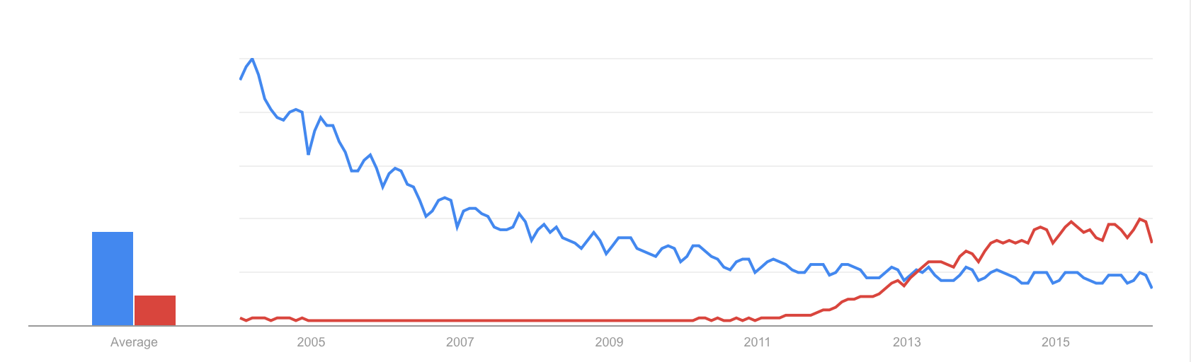
Market Evolution
Databases to Big Data
Databases
Big Data
Source: Google Trends
Notes:
One thing to note here is how recent all of this attention is – keep in mind that Spark was only founded in 2009 and open-sourced in 2010
So its very new, but there is tremendous interest in it already
Importance of the Apache Project
Trends industry – trend also IBM investments, and product, …
"Harvard Business Review recently called data science 'The Sexiest Job of the 21st Century.' “
It's not just sexy: for millions of managers and students who need to solve business problems with big data, it's indispensable..
MapReduce ineffectiveness
IBM Big Data & Analytics © 2016 IBM Corporation

Slide 3
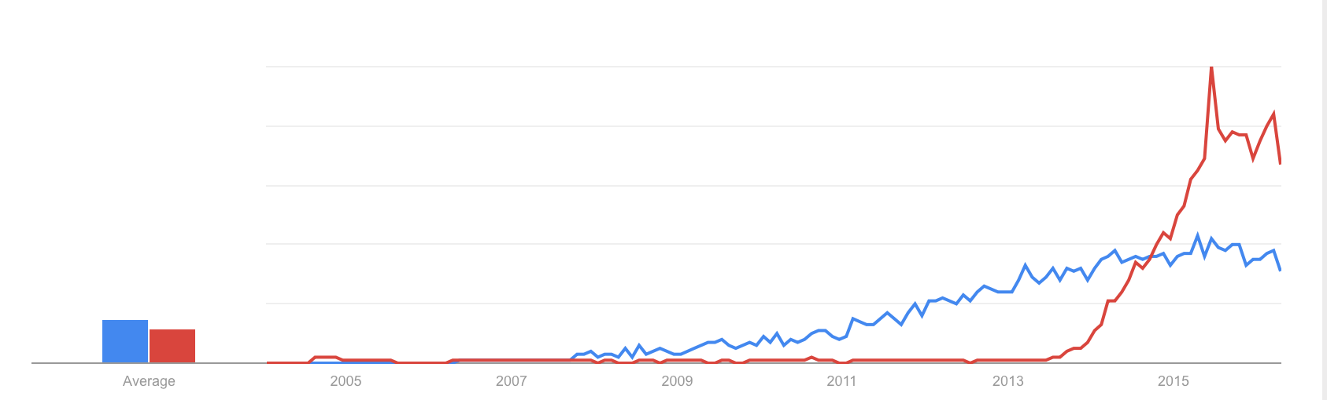
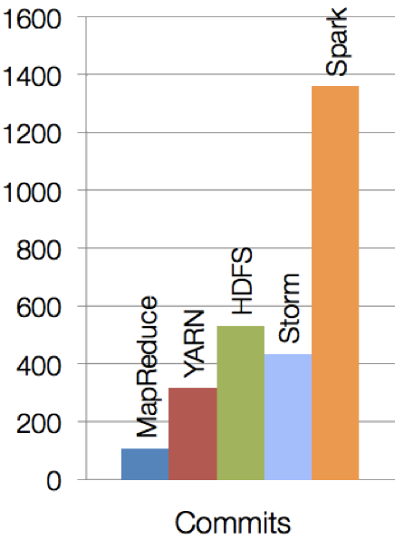
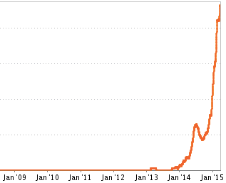
Spark is new, but evolving quickly and has gained tremendous traction in a short amount of time
Spark is one of the most active open source projects
Hadoop vs Spark (Google Trends)
Spark Job Trends (Indeed.com)
Notes:
One thing to note here is how recent all of this attention is – keep in mind that Spark was only founded in 2009 and open-sourced in 2010
So its very new, but there is tremendous interest in it already
Importance of the Apache Project
Trends industry – trend also IBM investments, and product, …
"Harvard Business Review recently called data science 'The Sexiest Job of the 21st Century.' “
It's not just sexy: for millions of managers and students who need to solve business problems with big data, it's indispensable..
MapReduce ineffectiveness
IBM Big Data & Analytics © 2016 IBM Corporation

Slide 4

What is Spark?
Spark is an open source
in-memory
application framework for
distributed data processing and
iterative analysis
on massive data volumes
“Analytic Operating System”
Notes:
Spark isn't a data store as it has to connect to other relational, non relational data stores, as well as handling data at rest and data on the fly (streams of data Other than the doesn't’t have its own.
Spark isn't only for Spark is a separate stand-alone system or service
Spark isn't only for Hadoop as it can be used without Hadoop as well, and to process and analyze data sources in other data sources like DashDB, any relationship database, Cloudant, Cassandra and Amazon S3.
Spark isn't only for machine learning – Spark includes machine learning and does it very well, but it can handle much broader tasks equally well
Spark isn't a replacement for Streams – Spark Streaming is micro-batching, not true streaming, and cannot handle the real-time complex event processing that true streams do in version 1.6
IBM’s objective is that we offer our customers the power of Spark in whichever way they want to leverage it. So Spark and Hadoop coexist in our portfolio, and IBM is committed to advancing Hadoop and using Spark to enhance the value of the information inside of Hadoop. For existing BigInsights customers or Hadoop adopter customers, it’s not an either-or situation; Spark can be used to analyze information in Hadoop, exploiting the investments made to put data there. For existing BigInsights customers or Hadoop adopter customers, it’s not an either-or situation; Spark can be used to analyze information in Hadoop, exploiting the investments made to put data there.
True multi purpose MPP (Massively Parallel Platform)
IBM Big Data & Analytics © 2016 IBM Corporation

Slide 5
Key reasons for interest in Spark
Performant
In-memory architecture greatly reduces disk I/O
Anywhere from 20-100x faster for common tasks
Productive
Concise and expressive syntax, especially compared to prior approaches
Single programming model across a range of use cases and steps in data lifecycle
Integrated with common programming languages – Java, Python, Scala
New tools continually reduce skill barrier for access (e.g. SQL for analysts)
Leverages existing investments
Works well within existing Hadoop ecosystem
Improves with age
Large and growing community of contributors continuously improve full analytics stack and extend capabilities
Notes:
Let’s say from the outset that Spark is a processing engine. It does not replace a Hadoop installation. It simply provides a way to access and process data. The result of this processing can then be stored in any available repository. When we talk about big data, we usually talk about a Hadoop repository. Here are the key reasons for the interest in Spark:
Many people talk about Spark’s performance compared to MapReduce. In fact, Databricks, the company that was started by the creator of Spark, was the first to make claims that Spark was 100x faster than MapReduce. They were pointing to a specific benchmark as a proof point. This is an extreme case but still, it happens. In many situations, the performance gain will be much more modest. Performance is not the most important aspect of the interest in Spark.
In my opinion, the most important aspect is Spark’s productivity compared to MapReduce. Spark learned from the MapReduce use cases and was able to abstract a lot of that processing into a set of pre-built functionality that gets the programmers to the crux of their problem instead of reinventing the wheel. The language is concise and expressive and has APIs with multiple languages, providing choices of programming environments (batch, interactive, semi-streaming) . As we’ll see on the next slide, Spark can be used in multiple contexts, providing one programming paradigm instead of having to learn different methods for different contexts. Finally, a set of higher level libraries are available, such as an SQL interface, that also increase productivity.
Spark is a processing engine. It can take advantage of a cluster environment to increase processing power and execution parallelism. It is a perfect fit in a Hadoop environment. Spark can read and write from/to the Hadoop distributed filesystem HDFS.
As a final point, the Spark community is very active and keeps growing. This means that Spark is evolving rapidly to answer the analytics needs of the enterprise.
Use SSD technology to show where we are at with platform computing
IBM Big Data & Analytics © 2016 IBM Corporation

Slide 6



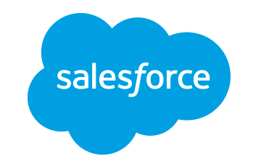












Spark includes a set of core libraries that enable various analytic methods which can process data from many sources
executes SQL statements
performs streaming analytics using micro-batches
common machine learning and statistical algorithms
distributed graph processing framework
Execute R
Statistical code against Spark Code
Spark SQL
Spark Streaming
MLlib (machine learning)
GraphX (graph)
SparkR
general compute engine, handles distributed task dispatching, scheduling and basic I/O functions
Spark Core Engine
large variety of data sources and formats can be supported, both on premise or cloud
BigInsights (HDFS)
Cloudant
dashDB
SQL DB
Object Storage
…many others
IBM CLOUD
OTHER CLOUD
CLOUD APPS
ON-PREMISE
Notes:
Where and how things fit together Note we are focused today on Spark SQL and MLlib stay tuned for more (hence the bolding for today)
Spark – has a core engine and set of libraries which consist of these 5 libraries
Where data comes from almost many different data sources ranging from relational, swift storage file system,,,
Spark – complements Hadoop – Collaboration
IBM Big Data & Analytics © 2016 IBM Corporation

Slide 7
Libraries Usage¹
Spark SQL
Spark Streaming
MLlib
Machine Learning
GraphX Graphing
SparkSQL − 69%
DataFrames − 62%
Spark Streaming − 58%
MLlib/GraphX − 58%
Spark Core
75% of users use more than one component
¹ From a survey done by Databricks, summer 2015
Notes:
Taken from a presentation from Matai Zaharia on Nov 2, 2015
From a survey done in the summer 2015.
Databricks did a survey in the summer 2015 to find out how people were using Spark. The results are listed here.
Note that DataFrames are a datasets that make the data look like relational tables. From that, we can conclude that SQL access to data is the most popular Interface used. Some would say it is ironic considering all the NoSQL hoopla of the last several years. This points to the fact that people want More productivity through the use of simpler interfaces. The SQL approach has that advantage and also potentially removes many performance burdens from a programmer.
IBM Big Data & Analytics © 2016 IBM Corporation

Slide 8
Spark Programming Languages
Language | 2014 | 2015 | 2016
Scala | 84% | 71% | 65%
Python | 38% | 58% | 62%
SQL | N/A | 36% | 44%
Java | 38% | 31% | 29%
R | unknown | 18% | 20%
Scala
  Functional programming
  Spark written in Scala
  Scala compiles into Java byte code
Java
  New features in Java 8 makes for more
  compact coding (lambda expressions)
Python
  Most widely used API with Spark today
R
  Functional programming language used to create and manipulate functions
Survey done by Databricks,
2015-2016
This probably means that more “data scientists” are starting to use Spark
DataFrames make all languages equally performant
Notes:
From Matei Zaharia presentation at IBM on Nov 2, 2015.
The Databricks survey also shows that the programming languages usage is changing. This is not to say that Scala is becoming less popular. It is likely because the type of people adopting Spark are coming more and more from a data science background which favors the use of Python and R.
A word of caution: Spark is written in Scala which is a language that compiles into Java byte code. This means that any functionality added to Spark Are automatically available in Scala (and likely Java). This is not the same for Python and R. On the bright side, the functionality gap between the languages is shrinking. We may get to a point where the differences wont matter.
IBM Big Data & Analytics © 2016 IBM Corporation

Slide 9
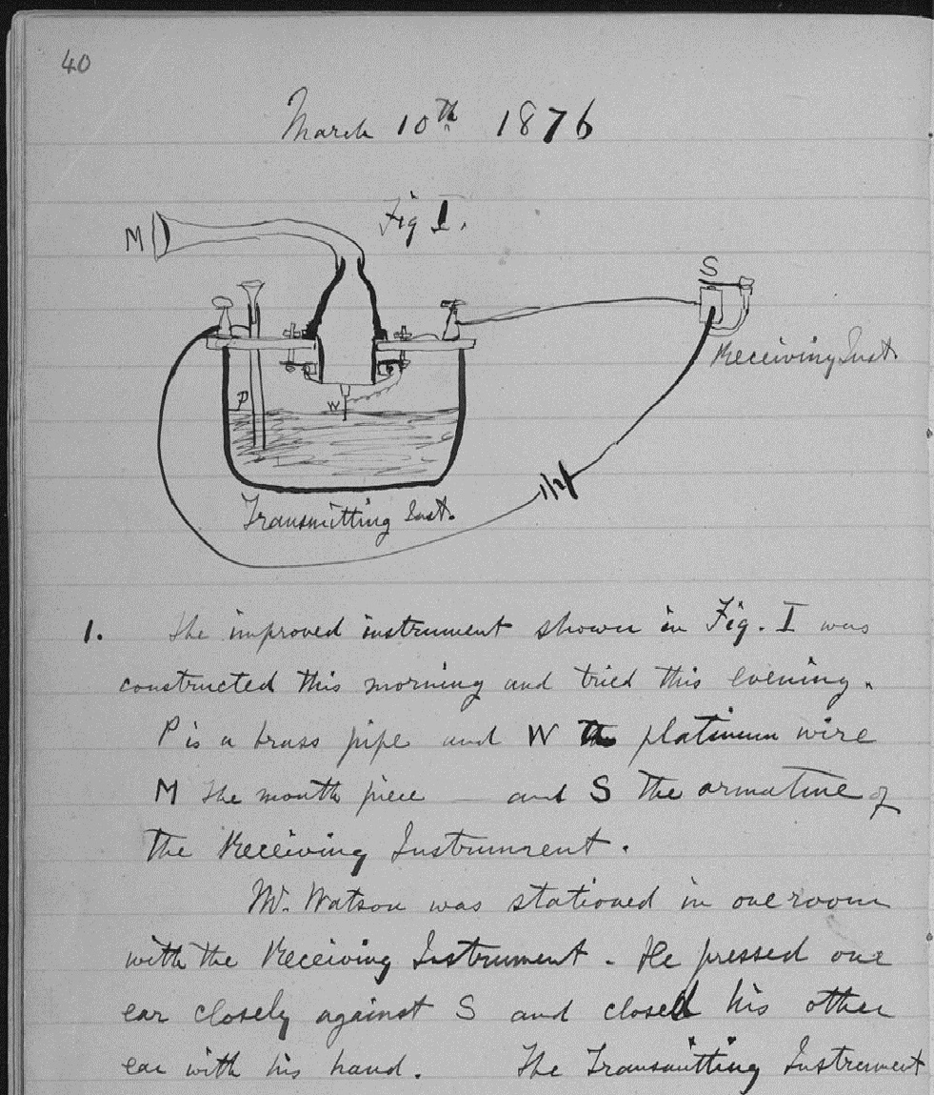
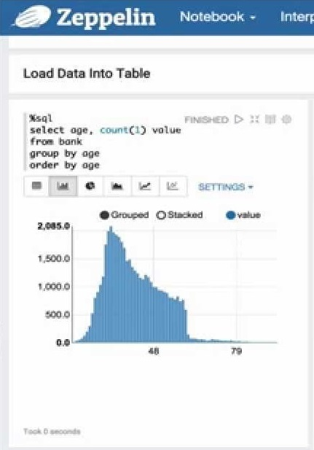
What is a “Notebook”?
Pen and Paper
Notebooks
Pen and paper has long provided the rich experience that scientists need to document progress through notes and drawings:
  Expressive
  Cumulative
  Collaborative
Notebooks are the digital equivalent of the “pen and paper” lab notebook, enabling data scientists to document reproducible analysis:
  Markdown and visualization
  Iterative exploration
  Easy to share
Notes:
So what is a “notebook”? Notebooks are basically the digital equivalent to the “pen and paper” lab notebook that you have always known. Much like how pen and paper has long provided the rich experience that scientists need to document progress through notes and drawings, notebooks enable data scientist to document reproducible analysis.
“Pen and paper” notebooks are very expressive and natural for scientists, enabling them to easily draw up ideas and make ad-hoc notes throughout their analysis. Notebooks for data science are very similar – they enable markdown, commenting, and visualization so that users can easily share and build on each other’s work. In a typical Notebook, a data scientist will have code (with potentially several different languages being used through the notebook), visualizations of data and summary statistics, code comments, and ad-hoc notes/discussions about what is happening throughout various sections of their data science project.
Notebooks are really well-suited to the exploratory phase of data science, where the scientists are looking for insights in the data and/or performing experiments based on certain hypothesis. It can also be a nice unified interface to a backend like Apache Spark, where you can leverage several different libraries within the same application.
IBM Analytics
© 2015 IBM Corporation

Slide 10
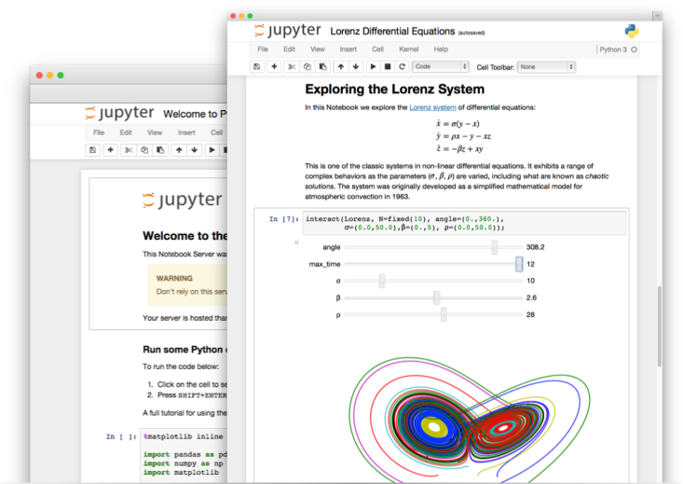

Web-Based Notebooks…
Notebooks:
“interactive computational environment, in which you can combine code
execution, rich text, mathematics, plots and rich media”
  Zeppelin
    Apache incubator project
    Suport multiple interpreters
      Scala, Python, SparkSQL
  Jupyter
    Based on Ipython
    Supports multiple interpreters
      Python, Scala
Data Scientist
&
Notebooks
Notes:
Definition taken from: http://ipython.org/notebook.html
The Spark community introduced (re-introduced?) the concept of notebook.
These notebooks provide a much more compelling environment that using, let’s say, the Spark shell.
The leading notebooks appear to be the Apache incubator project Zeppelin and the IPython/Jupyter notebook.
Currently the Bluemix Apache Spark service comes with the Jupyter notebook. The Ipython-based notebooks are popular since they are
Already known by Python users. Still, Zeppelin provides compelling functionality. It is easy to imagine having Spark environments
Where we could have a choice of notebook.

Slide 11
Apache Spark Under the hood!
Notes:
IBM Big Data & Analytics © 2016 IBM Corporation

Slide 12
Spark Terminology
Context (Connection):
  Represents a connection to the Spark cluster. The Application which initiated the context can submit one or several jobs, sequentially or in parallel, batch or interactively.
Driver (Coordinator agent)
  The program or process running the Spark context. Responsible for running jobs over the cluster and converting the App into a set of tasks
Job (Query / Query plan):
  A piece of logic (code) which will take some input from HDFS (or the local filesystem), perform some computations (transformations and actions) and write some output back.
Stage (Subplan)
  Jobs are divided into stages
Tasks (Sub section)
  Each stage is made up of tasks. One task per partition. One task is executed on one partition (of data) by one executor
Executor (Sub agent)
  The process responsible for executing a task on a worker node

Slide 13
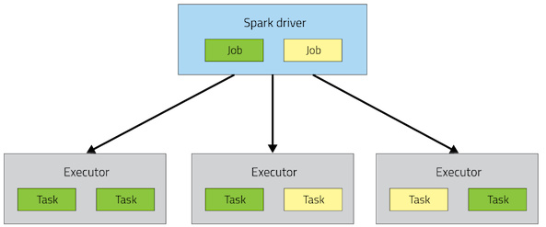
Spark Architecture
Application

Slide 14
Spark Architecture
A Spark application is initiated from a driver program
Each Spark application runs as a set of processes coordinated by the Spark context object (driver program)
  Spark context connects to Cluster Manager (standalone, Mesos/Yarn)
  Spark context acquires executors (JVM instance)
  on worker nodes
  Spark context sends tasks to the executors
Worker Node
Executor
Cache
Task
Task
Driver Program
Cluster Manager
App
SparkContext
Worker Node
Executor
Cache
Task
Task

Slide 15
Resilient Distributed Datasets
RDD is a distributed collection of Scala/Python/Java objects of the same type:
  Strings
  Integers
  (key, value) pairs
  class Java/Python/Scala objects
RDDs are immutable
  Modifications create new RDDs
Physically distributed across cluster, but manipulated as one logical entity:
  Spark will “distribute” any required processing to all partitions where the RDD exists and perform necessary redistributions and aggregations as well.
  Example: Consider a distributed RDD “Names” made of names
Partition 1
Partition 2
Partition 3
Names
Mokhtar
Jacques
Dirk
Cindy
Dan
Susan
Dirk
Frank
Jacques

Slide 16
Resilient Distributed Datasets
Suppose we want to know the number of names in the RDD “Names”
User simply requests: Names.count()
  Spark will “distribute” count processing to all partitions so as to obtain:
    Partition 1: Mokhtar(1), Jacques (1), Dirk (1) ➔ 3
    Partition 2: Cindy (1), Dan (1), Susan (1) ➔ 3
    Partition 3: Dirk (1), Frank (1), Jacques (1) ➔ 3
  Local counts are subsequently aggregated: 3+3+3=9
To lookup the first element in the RDD: Names.first()
To display all elements of the RDD: Names.collect() (careful with this)
Names
Partition 1
Partition 2
Partition 3
Mokhtar
Jacques
Dirk
Cindy
Dan
Susan
Dirk
Frank
Jacques

Slide 17
RDDs
Two types of operations
  Transformations ~ DDL (Create View V2 as…)
    val rddNumbers = sc.parallelize(1 to 10): Numbers from 1 to 10
    val rddNumbers2 = rddNumbers.map (x => x+1): Numbers from 2 to 11
    The LINEAGE on how to obtain rddNumbers2 from rddNumber is recorded
    It’s a Directed Acyclic Graph (DAG)
    No actual data processing does take place ➔ Lazy evaluations, no Execution
  Actions ~ Select (Select * From V2…)
    rddNumbers2.collect(): Array [2, 3, 4, 5, 6, 7, 8, 9, 10, 11]
    Performs transformations and action
    Returns a value (or write to a file) ➔ Executes on Cluster
Fault tolerance
  If data in memory is lost it will be recreated from lineage

Slide 18
Code Execution (1)
‘spark-shell’ provides Spark context as ‘sc’
// Create RDD
val quotes = sc.textFile("hdfs:/sparkdata/sparkQuotes.txt")
// Transformations
val danQuotes = quotes.filter(_.startsWith("DAN"))
val danSpark = danQuotes.map(_.split(" ")).map(x => x(1))
// Action
danSpark.filter(_.contains("Spark")).count()
File: sparkQuotes.txt
DAN Spark is cool
BOB Spark is fun
BRIAN Spark is great
DAN Scala is awesome
BOB Scala is flexible
Notes:
RDD
Spark’s basic unit of data
Immutable, fault tolerant collection of elements that can be operated on in parallel across a cluster
Two types of operations
Transformations
Data lineage DAG (Directed Acyclic Graph)
Single run with many stages, versus multiple jobs with MR
Lazy evaluations
Actions
Performs transformations and action
Returns a value
Fault tolerance
If data in memory is lost it will be recreated from lineage
Caching, persistence (memory, spilling, disk) and check-pointing
Transformations are lazy evaluations
Returns a pointer to the transformed RDD
Actions returns values

Slide 19
Code Execution (2)
// Create RDD
val quotes = sc.textFile("hdfs:/sparkdata/sparkQuotes.txt")
// Transformations
val danQuotes = quotes.filter(_.startsWith("DAN"))
val danSpark = danQuotes.map(_.split(" ")).map(x => x(1))
// Action
danSpark.filter(_.contains("Spark")).count()
File: sparkQuotes.txt
RDD: quotes
DAN Spark is cool
BOB Spark is fun
BRIAN Spark is great
DAN Scala is awesome
BOB Scala is flexible

Slide 20
Code Execution (3)
// Create RDD
val quotes = sc.textFile("hdfs:/sparkdata/sparkQuotes.txt")
// Transformations
val danQuotes = quotes.filter(_.startsWith("DAN"))
val danSpark = danQuotes.map(_.split(" ")).map(x => x(1))
// Action
danSpark.filter(_.contains("Spark")).count()
File: sparkQuotes.txt
RDD: quotes
RDD: danQuotes
DAN Spark is cool
BOB Spark is fun
BRIAN Spark is great
DAN Scala is awesome
BOB Scala is flexible

Slide 21
Code Execution (4)
// Create RDD
val quotes = sc.textFile("hdfs:/sparkdata/sparkQuotes.txt")
// Transformations
val danQuotes = quotes.filter(_.startsWith("DAN"))
val danSpark = danQuotes.map(_.split(" ")).map(x => x(1))
// Action
danSpark.filter(_.contains("Spark")).count()
File: sparkQuotes.txt
RDD: quotes
RDD: danQuotes
RDD: danSpark
DAN Spark is cool
BOB Spark is fun
BRIAN Spark is great
DAN Scala is awesome
BOB Scala is flexible

Slide 22
Code Execution (5)
// Create RDD
val quotes = sc.textFile("hdfs:/sparkdata/sparkQuotes.txt")
// Transformations
val danQuotes = quotes.filter(_.startsWith("DAN"))
val danSpark = danQuotes.map(_.split(" ")).map(x => x(1))
// Action
danSpark.filter(_.contains("Spark")).count()
File: sparkQuotes.txt
RDD: quotes
RDD: danQuotes
RDD: danSpark
HadoopRDD
DAN Spark is cool
BOB Spark is fun
BRIAN Spark is great
DAN Scala is awesome
BOB Scala is flexible
DAN Spark is cool
BOB Spark is fun
BRIAN Spark is great
DAN Scala is awesome
BOB Scala is flexible
DAN Spark is cool
DAN Scala is awesome
Spark
Scala
1

Slide 23
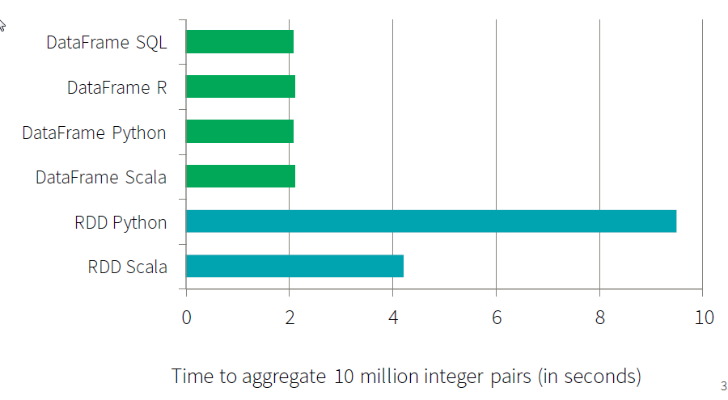
SparkSQL, DataFrames and DataSets
A rich set of functionality that allows “Database-like” processing
Share single optimizer, called “Catalyst” (at the driver)
  An open-source extensible query optimizer
Because it is the same engine, it has exactly the same performance for different APIs
  And performance is much better than for RDD
Much less code
All SparkSQL, DF, and DataSets are essentially using the same engine
Picture credit: databricks.com
Notes:
Data Sets is strongly typed so where you specify the data type such as a String, ….versus a DataFrame is strictly a schema w/o types
Mixing of sql with programmatic data manipulation
Single application combining analytics with sql
Sql is the perferred way to deal with structured and semi structured data
IBM Big Data & Analytics © 2016 IBM Corporation

Slide 24
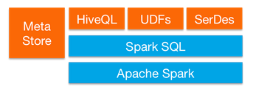
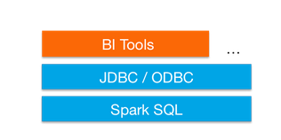
SparkSQL
Provide for relational queries expressed in SQL, HiveQL using Scala, Python, and Java API’s
Seamlessly mix SQL queries with Spark programs
Dataframes provide a single interface for efficiently working with structured data including Apache Hive, Parquet and JSON files
Graduated from alpha status with Spark 1.3
  DataFrames API marked as experimental in 2013
Standard connectivity through JDBC/ODBC
Notes:
Spark 2.0 due out in May /June 2016
IBM Big Data & Analytics © 2016 IBM Corporation

Slide 25


Spark Streaming
Component of Spark
  Project started in 2012
  First alpha release in Spring 2013
  Out of alpha with Spark 0.9.0
  More enhancements targeted for Spark 2.0
Discretized Stream (DStream) programming abstraction
  Represented as a sequence of RDDs (micro-batches)
  RDD: set of records for a specific time interval
  Supports Scala, Java, and Python (with limitations)
Fundamental architecture: batch processing of datasets
Notes:
Spark Streaming is an extension of the core Spark API. The project was started in 2012, released as alpha in the spring of 2013. It came out of alpha with the Spark 0.9.0 release in February 2014.
It defines a new abstraction: Discretized Streams or DStreams. DStream represents a sequence of RDDs where each RDD is a collection or records that accumulated within a specific time interval.
Just like Spark, it supports Scala, Java and, with limitations, Python.
We have to understand that Spark Streaming is a construct that depends on Spark. Spark Streaming consists of the submissions of Spark jobs at specific intervals. So in this context, as the submission rate increases, it becomes a higher percentage of the overall processing load.
IBM Big Data & Analytics © 2016 IBM Corporation

Slide 26
Spark MLlib
Spark MLlib for machine learning library
  Marked as under active development
Provides common algorithm and utilities
  Classification
  Regression
  Clustering
  Collaborative filtering
  Dimensionality reduction
Leverages iteration and yields better results than one-pass approximations sometimes used with MapReduce
Notes:
Clustering Recommendation Engines
Machine Learning came from IBM Research
It divides into two packages: spark.mllib contains the original API built on top of RDDs. And spark.ml provides higher-level API built on top of DataFrames for constructing ML pipelines.
http://spark.apache.org/docs/latest/mllib-guide.html
Classification – decision trees , linear regression, logistics
Regression -
Clustering
Collaborative Filtering – Recommendation
IBM Big Data & Analytics © 2016 IBM Corporation

Slide 27
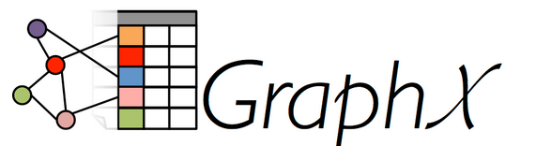
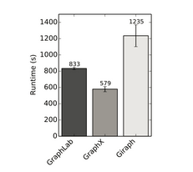
Spark GraphX
Flexible Graphing
  GraphX unifies ETL, exploratory analysis, and iterative graph computation
  You can view the same data as both graphs and collections, transform and join graphs with RDDs efficiently, and write custom iterative graph algorithms with the API
  GraphFrames - graph library based on Data Frames
Speed
  Comparable performance to the fastest specialized graph processing systems.
Algorithms
  Choose from a growing library of graph algorithms
  In addition to a highly flexible API, GraphX comes with a variety of graph algorithms
Notes:
Check release of Graph Frames
Documentation http://spark.apache.org/docs/latest/graphx-programming-guide.html
Extenstion to the rdd api and is a common graph algorithmm used for page rankingor triangulation
IBM Big Data & Analytics © 2016 IBM Corporation

Slide 28
Spark R
Spark R is an R package that provides a light-weight front-end to use Apache Spark from R
Spark R exposes the Spark API through the RDD class and allows users to interactively run jobs from the R shell or RStudio on a cluster.
Goals
  Make Spark R production ready
    Efforts from AlteryX and DataBricks
  Integration with MLlib
  Consolidations to the data frame and RDD concepts
Notes:
Good Documentation - http://spark.apache.org/docs/latest/sparkr.html
SparkR is an R package that provides a light-weight frontend to use Apache Spark from R. In Spark 1.6.1, SparkR provides a distributed data frame implementation that supports operations like selection, filtering, aggregation etc. (similar to R data frames, dplyr) but on large datasets. SparkR also supports distributed machine learning using MLlib.
SparkR supports operating on a variety of data sources through the DataFrame interface. This section describes the general methods for loading and saving data using Data Sources. You can check the Spark SQL programming guide for more specific options that are available for the built-in data sources.
The general method for creating DataFrames from data sources is read.df. This method takes in the SQLContext, the path for the file to load and the type of data source. SparkR supports reading JSON and Parquet files natively and through Spark Packages you can find data source connectors for popular file formats like CSV and Avro. These packages can either be added by specifying --packages with spark-submit or SparkR commands, or if creating context through init you can specify the packages with the packages argument.
SparkR DataFrames Starting Up: SparkContext, SQLContext
Starting Up from RStudio
Creating DataFrames , From local data frames, Data Sources, From Hive tables
DataFrame Operations - Selecting rows, columns, Grouping, Aggregation, Operating on Columns
Running SQL Queries from SparkR
Machine Learning Gaussian GLM model
Binomial GLM model
IBM Big Data & Analytics © 2016 IBM Corporation

